Slide 1
Data Analyst Nanodegree
Session 1
Conducted by: Hamza
Notes:
https://udacity.zoom.us/j/7991233356

Slide 2
Slack / SUPPORT / REPOs
https://join.slack.com/t/egypt-fwd-october-21/shared_invite/zt-vxuir09y-uFpiCgUqPlMw3UNAlCkwgg
fwd-support@udacity.com
https://github.com/santarabantoosoo/Data-Analysis-NanoDegree
https://github.com/santarabantoosoo/Data-Analyst-ND-presentations

Slide 3



Slide 4



Slide 5



Slide 6
agenda
Orientation
Analytics/stat/ML/…
Pandas refreshment
Pandas plotting refreshment
Breakout room

Slide 7
Points to consider
Connect session same time same day
Revoking
Better come prepared
Ask for help tool
Plagiarism

Slide 8






Getting started
https://www.udacity.com/bertelsmann-tech-scholarships
Notes:
Ask questions
Answer questions
Post resources
Share ideas of projects and ask for collaborators
Share life hacks
Share job opportunities

Slide 9
Breakout rooms
Leaders
Qualifications

Slide 10


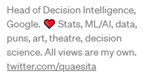

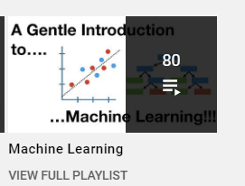
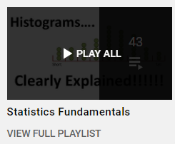
خد فكرة

Slide 11
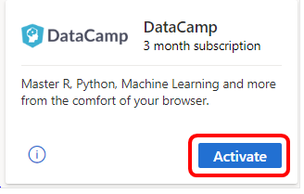
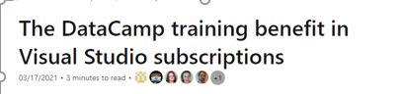
https://docs.microsoft.com/en-us/visualstudio/subscriptions/vs-datacamp

Slide 12
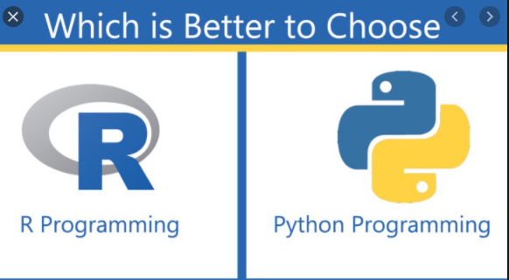
العركة

Slide 13

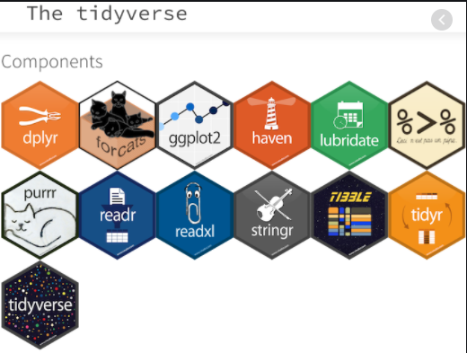


Slide 14
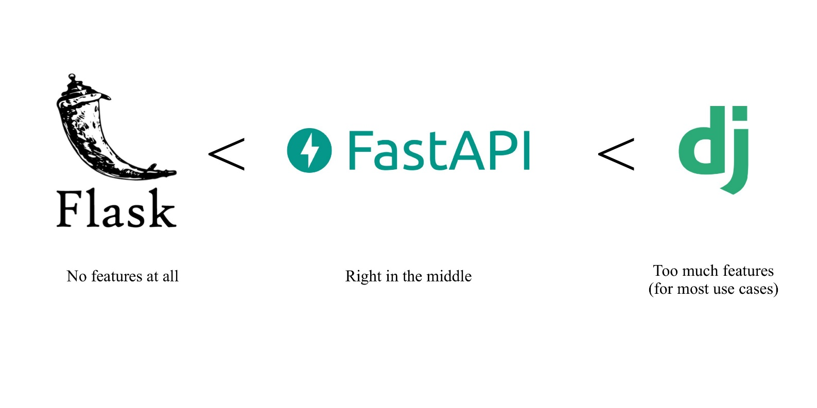
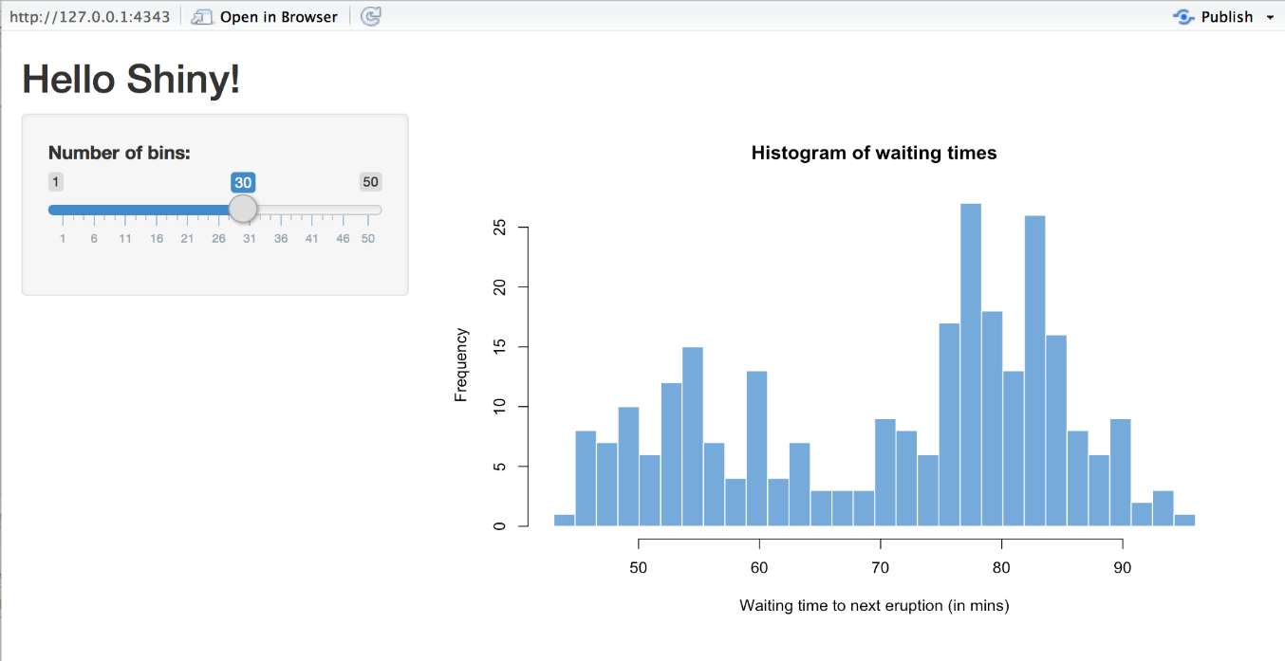


Slide 15



Machine learning

Slide 16

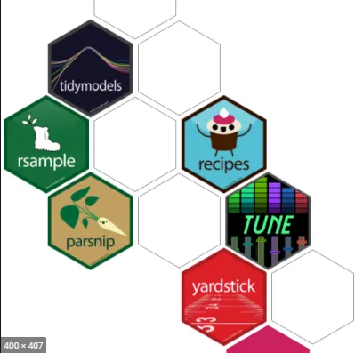
Think again?

Slide 17

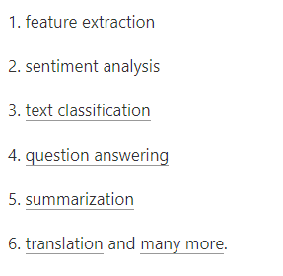
Deep learning
Huggingface

Slide 18


Omdena

Slide 19

No solution for r?

Slide 20

Think again

Slide 21

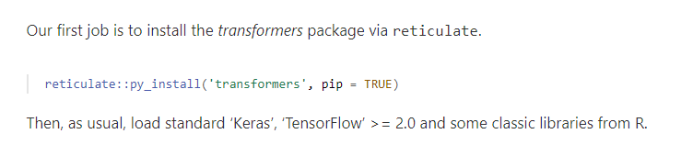
Notes:
RStudio AI Blog: State-of-the-art NLP models from R
https://blogs.rstudio.com/ai/posts/2020-07-30-state-of-the-art-nlp-models-from-r/

Slide 22
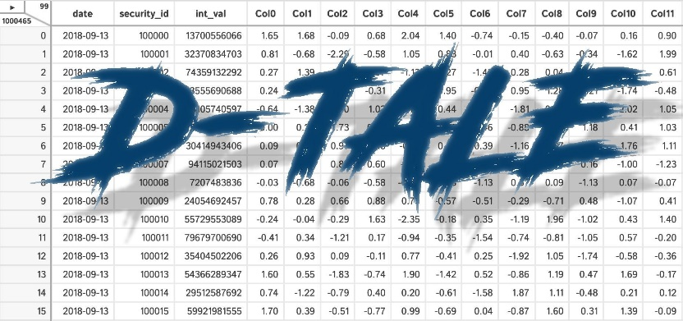

Bottom line?
1.
2. SEARCH – KEEP UPDATED!
Notes:
It doesn’t really matter. U can use both

Slide 23
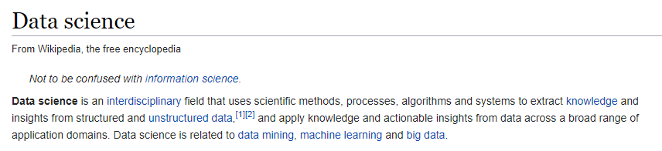
Data science
Statistics
Data science
Exploratory data analysis
Data analytics
What and why?

Slide 24
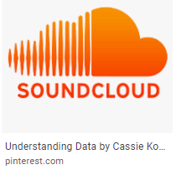
Data science
Make data useful

Slide 25
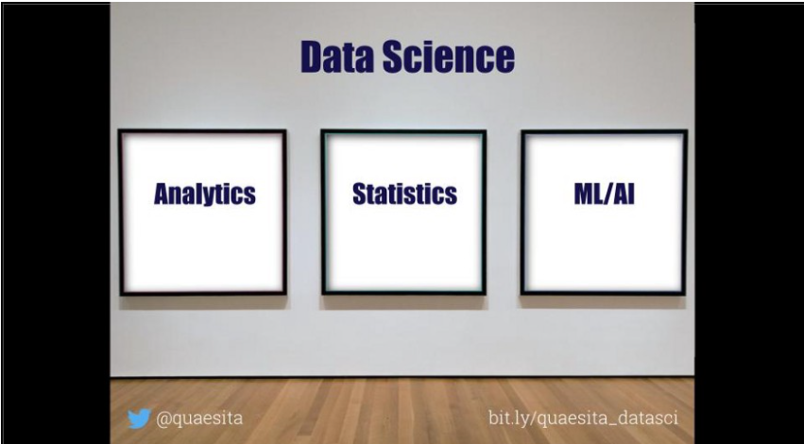
العركة؟
What’s the difference?

Slide 26
Analytics vs stats vs ML?
Notes:
The SQL vs R vs Python taxonomy is ill-advised for so many reasons, not least of which is that software evolves. (As of recently, you can even do ML in SQL.) Wouldn’t you prefer a breakdown that’ll last?
by the algorithm (surprise! it’s how university courses are structured). Pretty please, don’t taxonomize by histograms vs t-tests vs neural networks. Frankly, if you’re clever and you have a point to make, you can use the same algorithm for any part of data science. It might look like Frankenstein’s monster, but I assure you it can be forced to do your bidding.

Slide 27
Make data useful

Slide 28
العركة؟
What’s the difference?

Slide 29
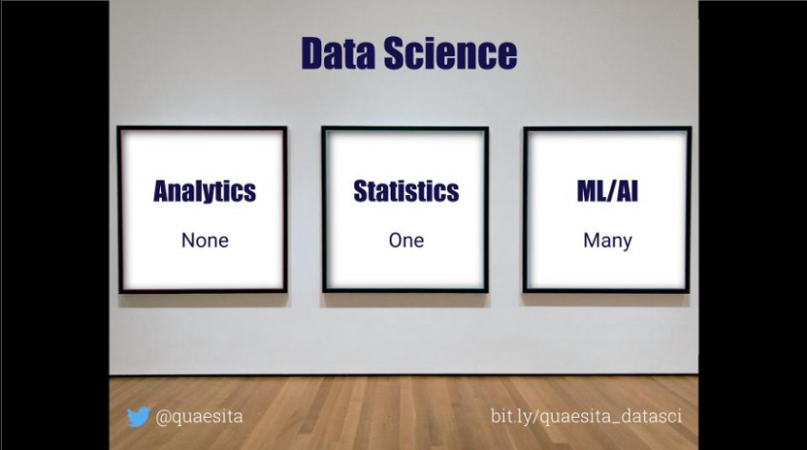
Decisions!
Which influence
real world actions?

Slide 30



Analytics vs (statistics/AI/ML/DP)

Slide 31

What u see?

Slide 32
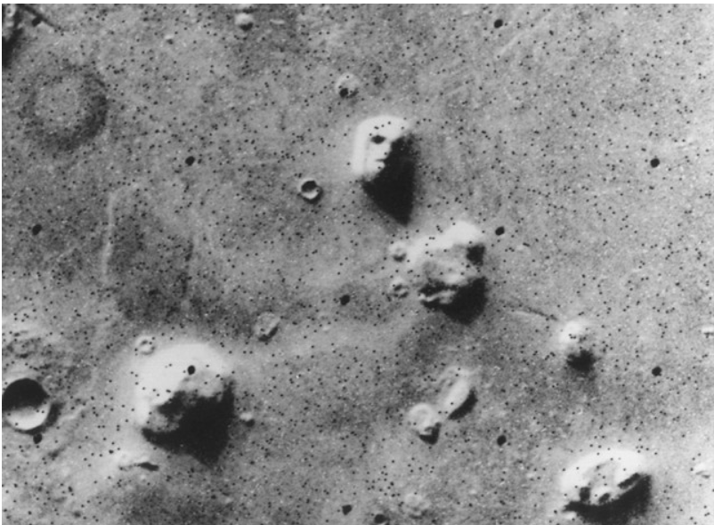

What u see, again?
12 sec shake?
Notes:
Satellite photo of the “Face on Mars” which many people took as evidence of extraterrestrial habitation.
How to know if there is indeed life on Mars? Test
How to know if 12 sec shake of ink can give u a butterfly image?
Retry

Slide 33
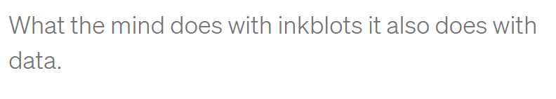
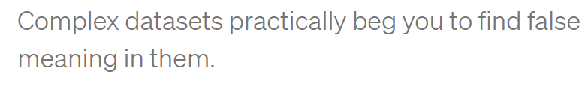

Slide 34
Analytics vs (statistics/AI/ML/DP)

Slide 35
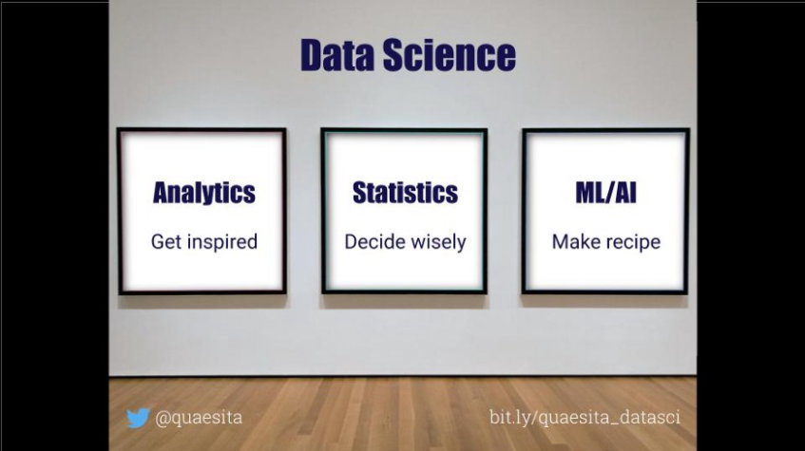

Slide 36



Which one to choose?
Notes:
All analytics
Speed
Discover
Brave – jump into nowhere

Slide 37
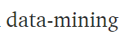
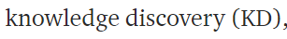
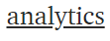
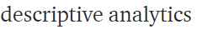
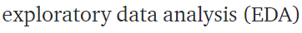
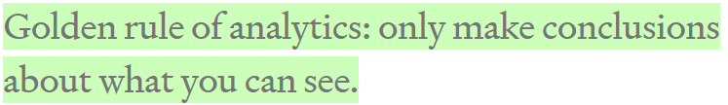
Data analytics
Notes:
The great news is that this one is easy. Think of your dataset as a bunch of negatives you found in a darkroom. Data-mining is about working the equipment to expose all the images as quickly as possible so you can see whether there’s anything inspiring on them. As with photos, remember not to take what you see too seriously. You didn’t take the photos, so you don’t know much about what’s off-screen. The golden rule of data-mining is: stick to what is here. Only make conclusions about what you can see, never about what you can’t see (for that you need statistics and lot more expertise).

Slide 38

Statistical inference
assumptions
Rigor
Notes:
is the drug useful ?
Should we change the logo?
Should we open a branch here or here ?

Slide 39

Notes:
A great example is that moment when your finger is hovering over the launch button for an AI system and it occurs to you that you need to check it works before releasing it (always a good idea, seriously). Step away from the button and call in the statistician.

Slide 40

Machine learning
Notes:
Can u boost the performance to 99.999?
Oh sure,
Then u r the guy

Slide 41
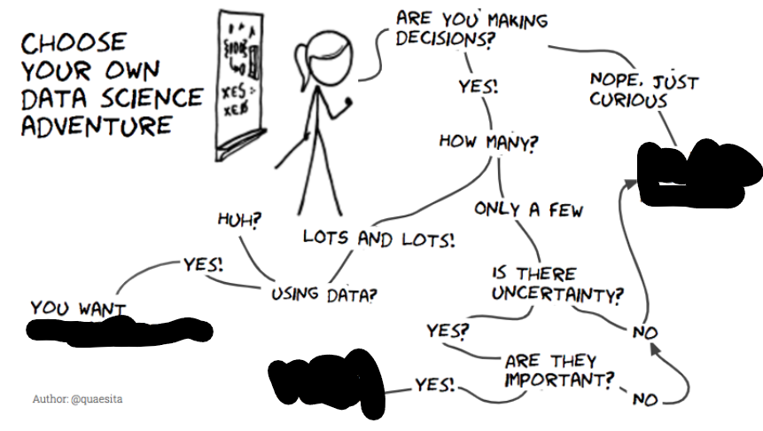

Slide 42
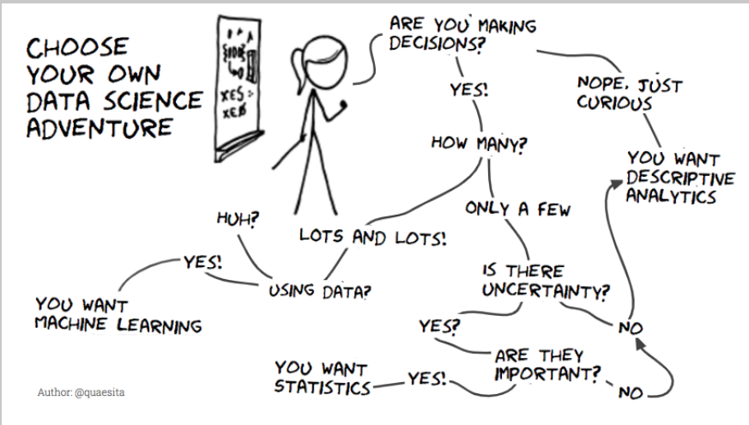

Slide 43
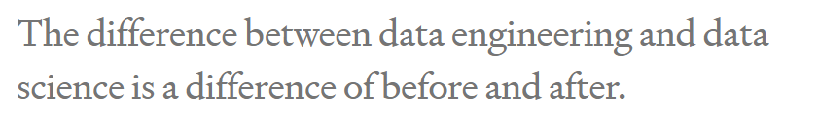
Data engineering
Notes:
the work that delivers data to the data science team in the first place? Since it’s a sophisticated field in its own right, I prefer to shield it from data science’s hegemonic aspirations. Besides, it’s much closer in species to software engineering than to statistics.
Feel free to see the data engineering versus data science difference as before versus after. Most of the technical work leading up to the birthing of the data (before) may comfortably be called “data engineering” and everything we do once some data have arrived (after) is “data science”.

Slide 44

want more?
Notes:
What on earth is data science?. The quest for a useful definition | by Cassie Kozyrkov | HackerNoon.com | Medium
https://medium.com/hackernoon/what-on-earth-is-data-science-eb1237d8cb37

Slide 45
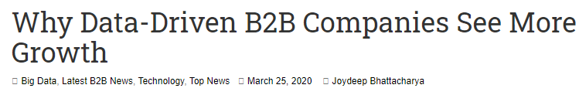

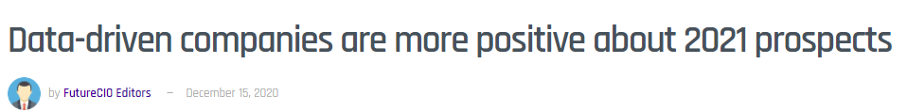
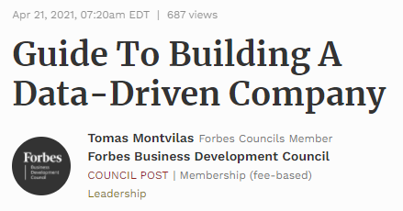
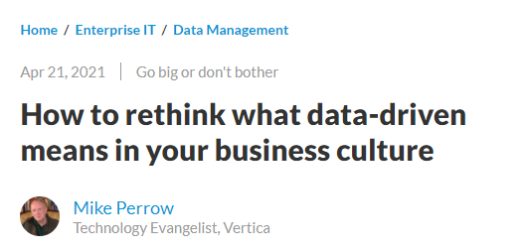

Slide 46

Data driven
Notes:
For a decision to be data-driven, it has to be the data — as opposed to something else entirely — that drive it. Seems so straightforward, and yet it’s so rare in practice because decision-makers lack a key psychological habit.
العربية الكارو محتاجة حمار عشان تبقى كارو

Slide 47

scenario
Notes:
Imagine that you are considering buying something online instead of making a pilgrimage to the other side of town to fetch it. You’ve boiled your decision down to whether or not you trust the online seller. A quick search yields some relevant data: you see that the seller has an average rating of 4.2 out of 5.

Slide 48
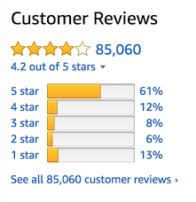
What u think?
Notes:
Now you can’t use that 4.2 to drive your decision. Game over! Once we’ve seen the answer, we’re free to pick the most convenient question. If the first thing we do is poke around in our data, our decision will be, at best, something I like to call data-inspired.

Slide 49
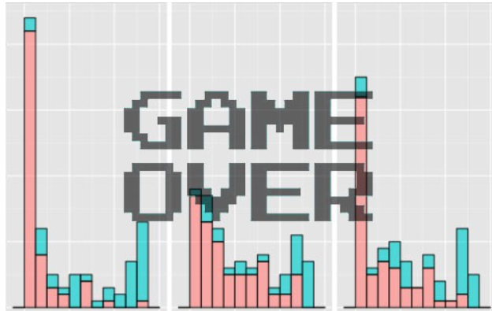
Data-drivenness destroyed
Any idea why?
Notes:
Once we’ve seen the answer, we’re free to pick the most convenient question

Slide 50
Data-drivenness destroyed
Once we’ve seen the
answer, we’re free to pick
the most convenient
question

Slide 51
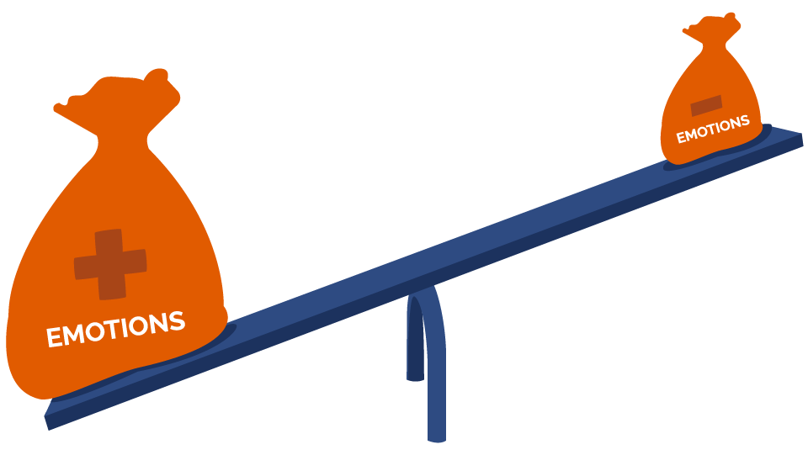

Notes:
That’s where we, like whales encountering plankton, swim around in some numbers, and then reach an emotional tipping point and… decide. There are numbers near our decision somewhere, but those numbers don’t drive it. The decision comes from somewhere else entirely.

Slide 52
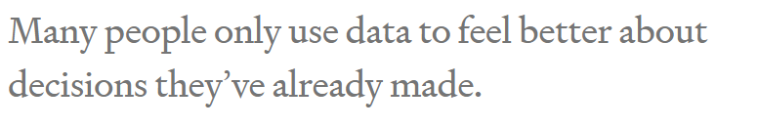

Slide 53
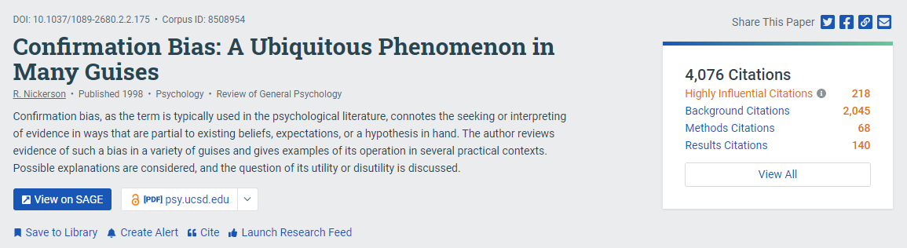
Notes:
The decision-maker’s mind was made up before the data, so the decision was there all along. Turns out humans interact with data selectively to confirm choices we’ve already made in our heart of hearts. We find the most convenient light in which to see evidence, and we don’t always know we’re doing it. Psychologists have a lovely name for this: confirmation bias.

Slide 54
Is it good?
Notes:
Positive
“It’s more than 4.0!”
They can even show a rigorous analysis about how it is statistically significantly higher than 4.0. (With certainty! It’s the p-value you’ve always wanted.)
Negative
“Why would I settle for a seller with less than 4.5 stars?” Or perhaps “But look at those 1-star reviews. I don’t like how many there are.” Sound familiar?

Slide 55
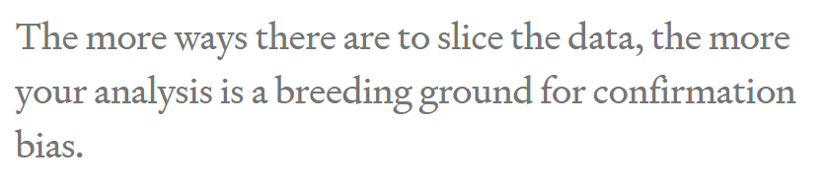

Slide 56

Solution
Notes:
Mathematical complexity doesn’t provide the antidote, it merely makes it harder to see the problem. As a result, what’s obvious in the trivial example we just saw becomes hidden in a jumble of gorgeous Gaussians. Don’t assume your friendly neighborhood data scientist sees it either. The more ways there are to slice the data, the more your analysis is a breeding ground for confirmation bias.

Slide 57
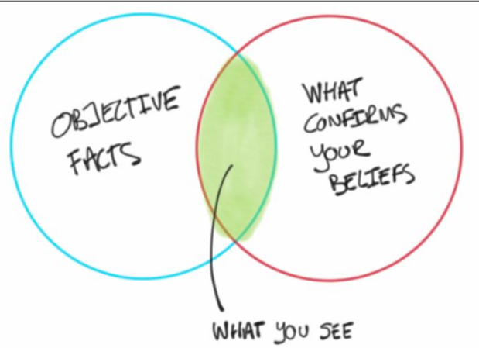
But why?

Slide 58

Notes:
feel better about doing what they were going to do anyway.

Slide 59


Any problem with real projects?
Notes:
It’s all about rating
What about a real pro

Slide 60



Expensive hobby

Slide 61

What’s the decision?
للأستاذة شيرين عبد الوهاب

Slide 62

Notes:
When decision-makers lack fundamental skills, there’s no math in the world that can fix it. Your data science team will not contribute to data-driven decision-making.

Slide 63

What if?
Notes:
nothing would be different if all those poor data scientists just made some numbers up

Slide 64


Cassie advice
Notes:
Data scientist friends, if your organization suffers from this kind of decision-maker, then I suggest sticking to the most lightweight and simple analyses to save time and money. Until the decision-makers are better trained, your showy mathematical jiu jitsu is producing nothing but dissipated heat.

Slide 65
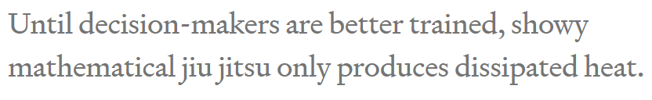

Slide 66

Problem
How to solve?
Notes:
Problem: you’re free to move the goalposts after you find out where the data landed. (Of course you score a goal every time. You’re just that good.)

Slide 67


Solution
Notes:
set the goalposts in advance and resist temptation to move them later.
Framing the decision and setting decision criteria is a science of its own
a quick fix that goes a long way is to come up with your decision boundary up front in your data science project.
resis

Slide 68

Practice
How to set goal first?

Slide 69

Solution
Notes:
she tugs at the pricetag on the back. “Hey, what does this say?” she asks me. “If it’s less than 80 bucks, I’ll buy it.”

Slide 70

Order matters
Notes:
Now that’s some decision intelligence! Instead of first seeing the price and then talking herself into a decision she’s already made, she uses the data to drive it. With a well-practiced reflex, she weighs how much she likes the dress and her budget, then sets the decision boundary, and only allows herself to see the data (price) once that’s done. She’s in the habit of using data in the right order and that’s a muscle you can exercise too.

Slide 71

Practice your data driven muscle
Notes:
People don’t always need to be data-driven and Emma knows that. She doesn’t have to make unimportant decisions that way, but she also knows that practice makes perfect. It’s much easier to build the habit on trivial decisions than to struggle when the important ones come around.

Slide 72

Negotiation 101
Notes:
I went to buy fireworks
I sticked to 80 pounds

Slide 73

What if I didn’t ?

Slide 74

Notes:
In fact, standard advice for negotiators is to think through the entire range of potential offer combinations and plan your reactions to them in advance, otherwise it’s very easy for an experienced opponent to take advantage of you. Even without all the persuasion tactics at your counterpart’s disposal, irrelevant short-term factors like your blood sugar levels, your mood, how much the other party is smiling, and whether the sun is shining can have a disproportionate effect on the deal.

Slide 75

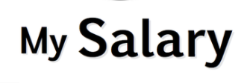
Apply for a job
Notes:
Next time you’re negotiating a salary, for example, make sure you’ve thought about your number before you hear theirs.
Whether you think about what a number means to you before or after you see it, you still have to think about it. Doing it beforehand helps you counter some of the bugs in your human programming, with large payoffs in decision quality and negotiation performance. Improving the order of operations here is a valuable habit to cultivate and crucial if you’d like to be involved in data-driven decision-making. And here’s some bonus good news: with practice it’ll feel automatic.

Slide 76
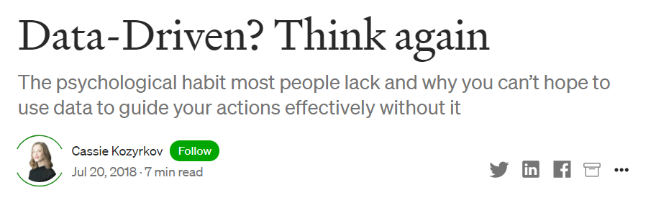

Notes:
Data-Driven? Think again. The psychological habit most people… | by Cassie Kozyrkov | HackerNoon.com | Medium
https://medium.com/hackernoon/data-inspired-5c78db3999b2

Slide 77

Pandas

Slide 78

axis

Slide 79

Axis = 0
Axis = 1
Axis = ‘rows’
Axis = ‘index’
Axis = ‘columns’
Notes:
What do they mean?

Slide 80
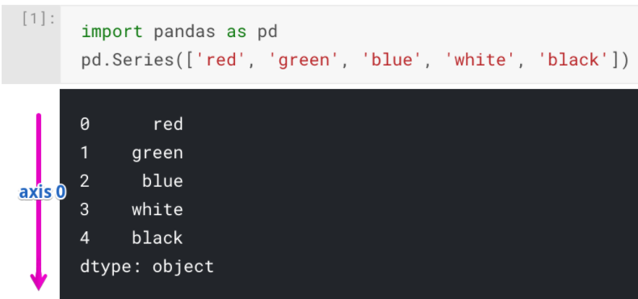
Series
Notes:
Python for Machine Learning: Pandas Axis Explained | Railsware Blog
https://railsware.com/blog/python-for-machine-learning-pandas-axis-explained/
Usually, in Python, one-dimensional structures are displayed as a row of values. On the contrary, here we see that Series is displayed as a column of values.

Slide 81
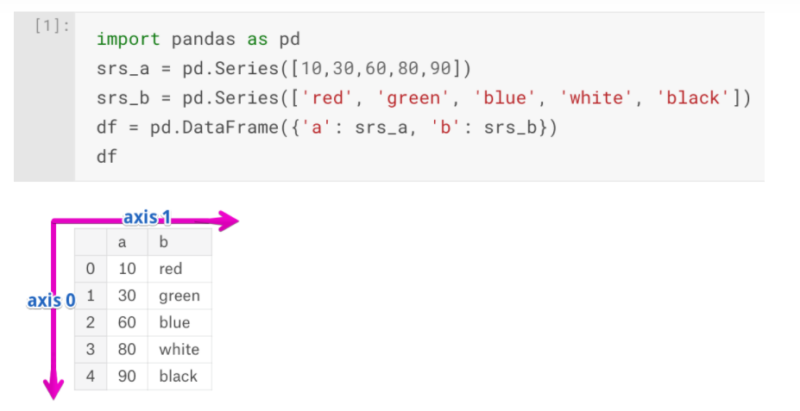
dataframe
Notes:
Our DataFrame object has 0, 1, 2, 3, 4 indexes along the “axis 0”, and additionally, it has “axis 1” indexes which are: ‘a’ and ‘b’.

Slide 82
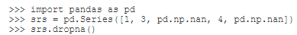
What’s the output?

Slide 83
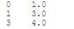
No difference [single axis]

Slide 84
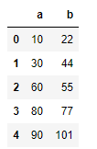
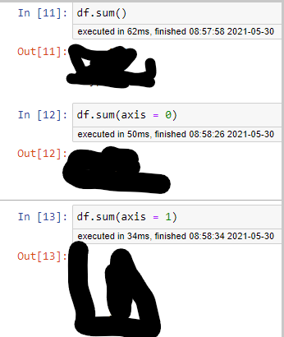
What’s the output?

Slide 85


Solution
Notes:
We see, that having sum with axis=0 smashed all values along the direction of the “axis 0” and left only columns(‘a’ and ‘b’) with appropriate sums.

Slide 86

Other solution
Notes:
If you prefer regular names instead of numbers, each axis has a string alias. “axis 0” has two aliases: ‘index’ and ‘rows’. “axis 1” has only one: ‘columns’. You can use these aliases instead of numbers:

Slide 87


Dropping NaN values
What to expect?

Slide 88


Solution
Notes:
Now .dropna collapsed “axis 1” and removed all columns with NaN values. Columns ‘a’ and ‘b’ contained NaN values, thus only ‘c’ column was left.

Slide 89



Concatenation
Output?

Slide 90


Concatenation
Notes:
Pandas borrowed the “axis” concept from NumPy library. The “axis” parameter does not have any influence on a Series object because it has only one axis

Slide 91

python

Slide 92

Better idea?

Slide 93


Which is better?
Notes:
Intro to programming nanodegree

Slide 94

Working or broken ?

Slide 95


solution
Notes:
1- str in list doesn’t matter
3- indentation

Slide 96

Infinite list

Slide 97

A better loop

Slide 98

indexing

Slide 99


Slide 100

range

Slide 101

solution

Slide 102



Slide 103

solution

Slide 104

F strings

Slide 105

solution

Slide 106

F strings

Slide 107


Slide 108


Slide 109
common String methods
Notes:
https://linuxhint.com/python_string_methods/

Slide 110




common list methods
Notes:
1 - The list words now has the words 'kangaroo' and 'wallaby' added to the end.
2- now the first item is “wallaby”
3- It changes words so that it's sorted in alphabetical order, starting with 'a' and ending with 'wallaby'.

Slide 111

List methods

Slide 112

solution

Slide 113

How to reverse the list?
Notes:
::-1 reverse the list
::2 skips one and prints [2,5]
::3 skips 2 and prints [2,7]

Slide 114

sets
Notes:
Ans : 6

Slide 115

sets
Notes:
maybe

Slide 116

sets

Slide 117


Slide 118

dictionary

Slide 119


Dictionary

Slide 120

solution

Slide 121



Slide 122

solution

Slide 123
How to add a pair?

Slide 124

Adding a pair

Slide 125

Dictionary exercise

Slide 126

solution

Slide 127

Notes:
*You can use curly braces to define a set like this: {1, 2, 3}. However, if you leave the curly braces empty like this: {} Python will instead create an empty dictionary. So to create an empty set, use set().
** A dictionary itself is mutable, but each of its individual keys must be immutable

Slide 128

Iterating through dictionaries

Slide 129



Slide 130

List comprehension

Slide 131

solution

Slide 132


Scope/ add a better example in python

Slide 133

Solution

Slide 134


functions

Slide 135

solution

Slide 136

What’s the mistake in here ?
Notes:
In this case, if it is happy, color will be gray, because the second if will run
The else is linked to the latest if

Slide 137

Solution

Slide 138
PS1=’>’
Terminal command so that working directory won’t appear.

Slide 139

functions

Slide 140

functions

Slide 141

functions

Slide 142

solution

Slide 143

Print and return from a script
Notes:
Only bears

Slide 144

Print and return from a file
Notes:
It prints the word none

Slide 145


Print and return from interpreter
Notes:
Prints hello to the console

Slide 146

Print and return from interpreter
Notes:
Both bears and 42 appeared in the terminal.
Like we saw earlier, there is a difference between returning a value and printing a value. There's also a difference in how these things behave depending on whether you're running them from a file or from interactive mode. In interactive mode, you'll see values that get printed and also any returned values (even when they aren't printed).

Slide 147


User input
Notes:
String

Slide 148

Errors

Slide 149

Notes:
It started with a single quote and it kept scanning to end the line when it reaches a single quote again, but it didn’t find it.

Slide 150

Tuples
Is it useful ?? In web development ?
Notes:
What is the output
Tuple and tuple ☺
U use it when it is imp to keep things unchanged

Slide 151

Handling errors

Slide 152


solution

Slide 153

Notes:
4 data types are available in python

Slide 154
To do
Notes:
Model interperation adjusted R squared (not mentioned in udacity)
Statquesy videos on statistics
Medium articles from jesse
Showcase a project that u have worked on
Correlation and why p value is silly
Datacamp regression in python
Extensive pandas exercise also tips and tricks for pandas
Python for data analysis book
Introduction to statistical learning in R chapter 3
AWESOME LINKS
PYTHON ONE LINERS
Show youtube video m kmal
Consider talking about interactions
Andrew NG regression
Hypthesis testing tom
Get libraries that can do logisitic regression and present tables easily using python as well as R
U can mention validation set

Slide 155
Stanford teasers
Kaggle competitions exploratory data analysis

Slide 156



Slide 157


Slide 158


Notes:
My objective is to argue that only a small subset of the library is sufficient to complete nearly all of the data analysis tasks that one will encounter.
Minimally Sufficient Pandas. In this article, I will offer an… | by Ted Petrou | Dunder Data | Medium
https://medium.com/dunder-data/minimally-sufficient-pandas-a8e67f2a2428

Slide 159

Aim
Notes:
Know why limiting Pandas to a small subset will keep your focus on the actual data analysis and not on the syntax
Have specific guidelines for taking a single approach to completing a variety of common data analysis tasks with Pandas

Slide 160

Minimally Sufficient Pandas
Have almost everything
Analysis not syntax
Notes:
It is a small subset of the library that is sufficient to accomplish nearly everything that it has to offer.
It allows you to focus on doing data analysis and not the syntax
Your code will be simple, explicit, straightforward, and boring
You will choose one obvious way to accomplish a task
You will use this obvious way every single time
You won’t have to retain as many commands in working memory
Your code will be easier to understand by others and by you

Slide 161


Standardizing common tasks
Notes:
Better collaboration
Lesser memorization

Slide 162


No Tricks
Notes:
Knowing many obscure Pandas tricks might impress your friends, but it doesn’t usually lead to good code
It can lead to long lines of code that are difficult to understand and may be harder to debug.
شوف ده وشوف ده

Slide 163


Let’s start
Notes:
The concrete examples were all derived by the following principle:
If a method does not provide any additional functionality over another method (i.e. its functionality is a subset of another) then it shouldn’t be used. Methods should only be considered if they have some additional, unique functionality.
Will koehrson

Slide 164


Selecting a Single Column of Data
Select state, color, fav food
and count
NB 2
Notes:
How to select state, color favorite food and count?
Notice that when selecting count, it states at the top ‘bound method DataFrame.count of’. Python is telling us that this is a method of some DataFrame object.
Also I can’t select fav food by dot notation
Will cover isA

Slide 165

The column name is a variable
Notes:
Failure

Slide 166

Autocompletion?

Slide 167

Notes:
Which AI Code Autocomplete Should You Choose? | The Startup
https://medium.com/swlh/kite-vs-tabnine-which-ai-code-autocomplete-should-you-choose-eb6eba85c3a6#:~:text=TabNine%20was%20released%20in%202019,Atom%2C%20Sublime%20Text%2C%20etc.

Slide 168


Slide 169

How to select rows and columns?
ix
loc
iloc
at
Iat

Slide 170


ix indexer
Why was it deprecated?
Notes:
The ix indexer was created in the early days of Pandas to select rows and columns by both label and integer location.
This turned out to be quite ambiguous as Pandas row and column names can be both integers and strings.

Slide 171
Solution?
loc ➔ label
iloc ➔ integer location
Notes:
Deprecated : مهملة
Move to jupyter

Slide 172
How to select rows and columns?
ix
loc
iloc
at
iat

Slide 173

Selection with at and iat
Only a single cell
Notes:
select a single cell of a DataFrame
These provide a slight performance advantage over their analogous loc and ilocindexers. But, they introduce the additional burden of having to remember what they do. Also, for most data analyses, the increase in performance isn’t useful unless it’s being done at scale. And if performance truly is an issue, then taking your data out of a DataFrame and into a NumPy array will give you a large performance gain.

Slide 174
How to select rows and columns?
ix
loc
iloc
at
Iat
Notes:
The documentation uses the term position for referring to integer location. I do not like this terminology as I feel it is confusing. Integer location is more descriptive and is exactly what .iloc stands for.
python - pandas loc vs. iloc vs. at vs. iat? - Stack Overflow
https://stackoverflow.com/questions/28757389/pandas-loc-vs-iloc-vs-at-vs-iat
A perfect ans by Ankit Agrawal

Slide 175
Method Duplication
Which one to choose?
Notes:
The isna method was added more recently because the characters na are found in other missing value methods such as dropna and fillna. Confusingly, Pandas uses NaN, None, and NaT as missing value representations and not NA.

Slide 176

Method Duplication
Which one to choose?
Do we need notna?
Notes:
The isna method was added more recently because the characters na are found in other missing value methods such as dropna and fillna. Confusingly, Pandas uses NaN, None, and NaT as missing value representations and not NA.
There are aliases. Choose whichever u like

Slide 177

Solution
Notes:
You can also avoid ever using notna since Pandas provides the inversion operator, ~ to invert boolean DataFrames.

Slide 178



Builtin Python vs Pandas
Which one
To use?
NB 4

Slide 179

Two datasets?
CONCAT
APPEND
JOIN
MERGE

Slide 180

Two datasets

Slide 181

SQL?
NB Combining dataframes

Slide 182


Ignore index
What to expect?

Slide 183


Solution

Slide 184

How to group and aggregate?
Notes:
finding the maximum SAT score per state

Slide 185



Guidance

Slide 186

Multiindex
How to?
How to remove?
Notes:
Relaffil = rel affiliation
A MultiIndex or multi-level index is a cumbersome addition to a Pandas DataFrame that occasionally makes data easier to view, but often makes it more difficult to manipulate. You usually encounter a MultiIndex after a call togroupby when using multiple grouping columns or multiple aggregating columns.
Here Both the rows and columns have a MultiIndex with two levels.
They have different syntax for making subset selections and are more difficult to use with other methods. If you are an expert Pandas user, you can get some performance gains when making subset selections,

Slide 187


Any difference?
Modify to
Get the
multiindex

Slide 188

Solution
How to revert
multilevel index?

Slide 189




Rename and reset
Rename columns
Reset index
Notes:
Guidance: Avoid using a MultiIndex. Flatten it after a call to groupby by renaming columns and resetting the index.

Slide 190

groupby vs pivot_table vs crosstab vs pivot

Slide 191



Which is which?
Wide vs
Long?
When to use?
Notes:
Groupby vs pivot_table
The wide format is the pivot table
Guidance: use pivot_table when comparing groups
I really like to use pivot tables to compare values across groups and a groupby when I want to continue an analysis. From above, it is easier to compare male to female salaries when using the output of pivot_table. The result is easier to digest as a human and its the type of data you will see in an article or blog post. I view pivot tables as a finished product.
The result of a groupby is going to be in tidy form, which lends itself to easier subsequent analysis, but isn’t as interpretable

Slide 192

Tidy
Notes:
Tidy Data | Wickham | Journal of Statistical Software
https://www.jstatsoft.org/article/view/v059i10

Slide 193

Similar?

Slide 194


pivot_table vs pd.crosstab
Notes:
The pivot_table method and the crosstab function can both produce the exact same results with the same shape. They both share the parameters index, columns, values, and aggfunc. The major difference on the surface is that crosstab is a function and not a DataFrame method.

Slide 195

How to get with pivot_table?

Slide 196

How to get with pivot_table?
What about cross_tab?

Slide 197

With cross_tab

Slide 198

Want relative frequency?

Slide 199

Pretty easy
Notes:
You also have the option of normalizing over the rows using the string ‘index’ or over the entire DataFrame with the string ‘all’ as seen below.

Slide 200

Normalizing over rows or df
Notes:
You also have the option of normalizing over the rows using the string ‘index’ or over the entire DataFrame with the string ‘all’ as seen below.

Slide 201
Bottom line
Cross_tab easier for frequency
It seems that it can do everything
I think I can recommend it over pivot_table

Slide 202

Pivot vs pivot_table

Slide 203

No aggregation
Notes:
Using the pivot method, reshapes the data without aggregating or doing anything to it. pivot_table, on the other hand, requires that you do an aggregation

Slide 204


Pivot Pitfalls
Notes:
it can only handle the case when both index and columns are set to a single column. If you want to keep multiple columns in the index then you cannot use pivot. Also, if any combination of index and columns appear more than once, then you will get an error as it does not perform an aggregation.
pivot_table can accomplish all of what pivot can do. In the case that you do not need to perform an aggregation, you still must provide an aggregation function.
I think cross_tab is a better alternative

Slide 205


Melt vs stack
How to reshape?
Notes:
Let’s reshape this data so that we have three columns, the airline, the airport and the arrival delay

Slide 206
Using melt
What about stack??
Notes:
Let’s reshape this data so that we have three columns, the airline, the airport and the arrival delay

Slide 207



Using stack
Set index
Use stack

Slide 208
Compare melt/stack output
melt
stack
How to revert multi-index?
Notes:
This returns a Series with a MultiIndex with two levels.

Slide 209



Slide 210



Melt advantage
Notes:
Renaming on the fly

Slide 211
Do we need apply?
Consider discussing this
But after reading more about `
Notes:
Also see this Perfect post on stackoverflow
python - When should I (not) want to use pandas apply() in my code? - Stack Overflow
https://stackoverflow.com/questions/54432583/when-should-i-not-want-to-use-pandas-apply-in-my-code#:~:text=It%20is%20because%20apply%20is,major%20overhead%20at%20each%20iteration.
How and why to stop using pandas .apply() (so much) | by Sven Harris | Towards Data Science
https://towardsdatascience.com/avoiding-apply-ing-yourself-in-pandas-a6ade4569b7f

Slide 212

Apply vs map vs applymap
Notes:
Introduction to Pandas apply, applymap and map | by B. Chen | Towards Data Science
https://towardsdatascience.com/introduction-to-pandas-apply-applymap-and-map-5d3e044e93ff

Slide 213



Apply
Can we use lambda?

Slide 214

Apply

Slide 215


Apply
Can we use lambda?

Slide 216

Apply

Slide 217

Notes:
applymap() is only available in DataFrame and used for element-wise operation across the whole DataFrame. It has been optimized and some cases work much faster than apply() , but it’s good to compare it with apply() before going for any heavier operation.

Slide 218



Slide 219

map

Slide 220



map
Notes:
map() is only available in Series and used for substituting each value in a Series with another value. To understand how the map() works, we first create a Series.
map() accepts a dict or a Series. Values that are not found in the dict are converted to NaN, unless the dict has a default value (e.g. defaultdict):

Slide 221

Notes:
To avoid applying the function to missing values (and keep them as NaN) na_action='ignore' can be used:

Slide 222












Best of the API

Slide 223
agenda
Orientation
Analytics/stat/ML/…
Data driven?
Pandas refreshment
Pandas plotting refreshment
First project
Breakout room

Slide 224


Setting the scene
Notes:
d represents the weighted average of 50 Indian company stocks in 17 sectors. The dataset is openly available on Kaggle, but we’ll be using a subset of the data containing the stock value of only four sectors – banking, pharma, IT, and FMCG.

Slide 225



what to expect?
Notes:
Where is the x?

Slide 227

Solution
Notes:
Where is the x?
You will also need to specify the x and y coordinates to be referenced as the x and y-axis. Since the Date is already the index column, it will be configured as the X-axis.

Slide 228

Other options?
https://pandas.pydata.org/pandas-docs/stable/reference/api/pandas.DataFrame.plot.html

Slide 229


Slide 230

Bar plots
Can we use a bar plot?

Slide 231

Solution: group/aggregate
Can we draw bar charts for all 4 columns?
Notes:
data.resample() is used to resample the stock data.
The ‘M’ stands for month-end frequency and denotes the offset values you want to resample the data.
mean() indicates the average stock price during this period.
Is the average per month or the last day only?

Slide 232

How to convert to bar.. Multiple bars?

Slide 233

Solution

Slide 234

Similar solution

Slide 235

How to get this?

Slide 236

Solution

Slide 237


Stacked?

Slide 238

What about horizontal stacked?

Slide 239
Correct ☺

Slide 240

Histograms vs bar plots?
Any differences?

Slide 241

Axes needed?
Sure for bar graph?
Notes:
1 for hist
2 for bar
What about count plot?

Slide 242


Countplot
http://seaborn.pydata.org/examples/index.html
Also check their tutorial tab

Slide 243

Histogram or bar plot?

Slide 244
Histogram or bar plot?
What does the code mean?
Notes:
The default bin value is 10. Bin size can be changed using the “bins” keyword.
Alpha sets the transparence
We selected only two columns

Slide 245

What to choose?

Slide 246
What to choose?

Slide 247

Other options
Notes:
A hexagonal bin plot, also known as a hexbin plot, can be used as an alternative to scatterplots. This kind of plot is particularly useful when the number of data points is huge, and each point cannot be plotted individually.

Slide 248

https://neptune.ai/blog/pandas-plot-deep-dive-into-plotting-directly-with-pandas?utm_source=datacamp&utm_medium=post&utm_campaign=blog-pandas-plot-deep-dive-into-plotting-directly-with-pandas
Notes:
Pandas objects come equipped with their plotting functions. These plotting functions are essentially wrappers around the matplotlib library. Think of matplotlib as a backend for pandas plots.
5 Minute Guide to Plotting with Pandas | by Rebecca Vickery | Towards Data Science
https://towardsdatascience.com/5-minute-guide-to-plotting-with-pandas-e8c0f40a1df4
Fast plotting with Pandas. Quickly visualize your data with these… | by Tom Waterman | Towards Data Science
https://towardsdatascience.com/the-best-pandas-plotting-features-c9789e04a5a0
Data Visualization with Pandas and Seaborn 🎓 | by Tirendaz Academy | Level Up Coding
https://levelup.gitconnected.com/data-visualization-with-pandas-and-seaborn-5de444b567a0
08.Pandas Visualization | jupyter notebooks gallery
https://notebook.community/vravishankar/Jupyter-Books/pandas/08.Pandas%20Visualization
Python for Librarians: Plotting Your Data - Pandas
https://librarycarpentry.org/library-python/06a-plotting-with-pandas/
5.0
https://phdphysics.cloud.ba.infn.it/wp-content/uploads/2017/06/8-Diacono-3Maggio.pdf
Univariate plots in pandas | Python
https://campus.datacamp.com/courses/python-for-r-users/plotting-4?ex=2
Pandas Foundations | DataCamp
https://learn.datacamp.com/courses/pandas-foundations?tap_a=5644-dce66f&tap_s=93618-a68c98
Data Science Courses: R & Python Analysis Tutorials | DataCamp
https://learn.datacamp.com/search?q=pandas+plot
Pandas Plot: Deep Dive Into Plotting Directly with Pandas - neptune.ai
https://neptune.ai/blog/pandas-plot-deep-dive-into-plotting-directly-with-pandas?utm_source=datacamp&utm_medium=post&utm_campaign=blog-pandas-plot-deep-dive-into-plotting-directly-with-pandas

Slide 249

Where to find real data?
Notes:
Popular open data repositories
UC Irvine Machine Learning Repository
Kaggle datasets
Amazon’s AWS datasets
Meta portals (they list open data repositories)
Data Portals
OpenDataMonitor
Quandl
Other pages listing many popular open data repositories
Wikipedia’s list of Machine Learning datasets
Quora.com
The datasets subreddit

Slide 250
Real data resources
Popular open data repositories
UC Irvine Machine Learning Repository
Kaggle datasets
Amazon’s AWS datasets
Meta portals (they list open data repositories)
Data Portals
OpenDataMonitor
Quandl
Other pages listing many popular open data repositories
Wikipedia’s list of Machine Learning datasets
Quora.com
The datasets subreddit

Slide 251


Frequent error

Slide 252
How to use Conda from the Jupyter Notebook
# DON'T DO THIS!
!conda install --yes numpy
import sys
!conda install --yes --prefix {sys.prefix} numpy
Notes:
Use the second option
That bit of extra boiler-plate makes certain that conda installs the package in the currently-running Jupyter kernel
Installing Python Packages from a Jupyter Notebook | Pythonic Perambulations
https://jakevdp.github.io/blog/2017/12/05/installing-python-packages-from-jupyter/

Slide 253
How to use Pip from the Jupyter Notebook¶
# DON'T DO THIS
!pip install numpy
import sys
!{sys.executable} -m pip install numpy
Notes:
That bit of extra boiler-plate makes certain that you are running the pip version associated with the current Python kernel, so that the installed packages can be used in the current notebook. This is related to the fact that, even setting Jupyter notebooks aside, it's better to install packages using
$ python -m pip install <package>
rather than
$ pip install <package>
because the former is more explicit about where the package will be installed (more on this below).

Slide 254
Breakout room

Slide 255
Investigate a dataset

